Slide 1
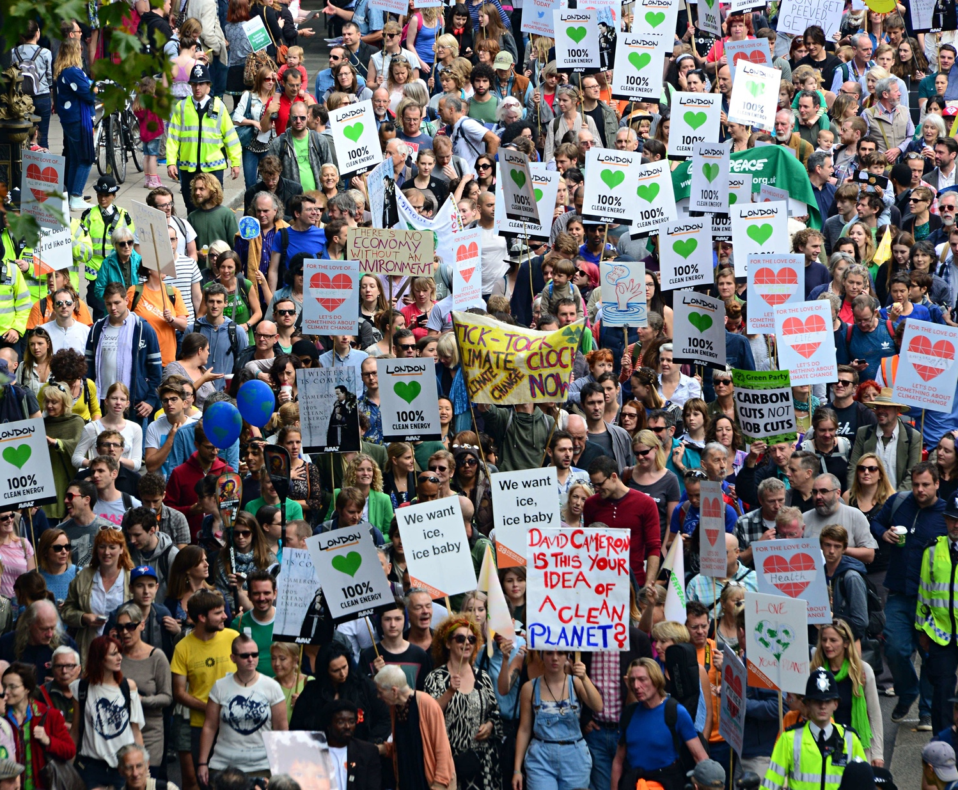
Perceptions, Protests and Public Policy:
A tool for analysing societies awareness of Climate Change in the UK
ONS Health Surveillance

Slide 2
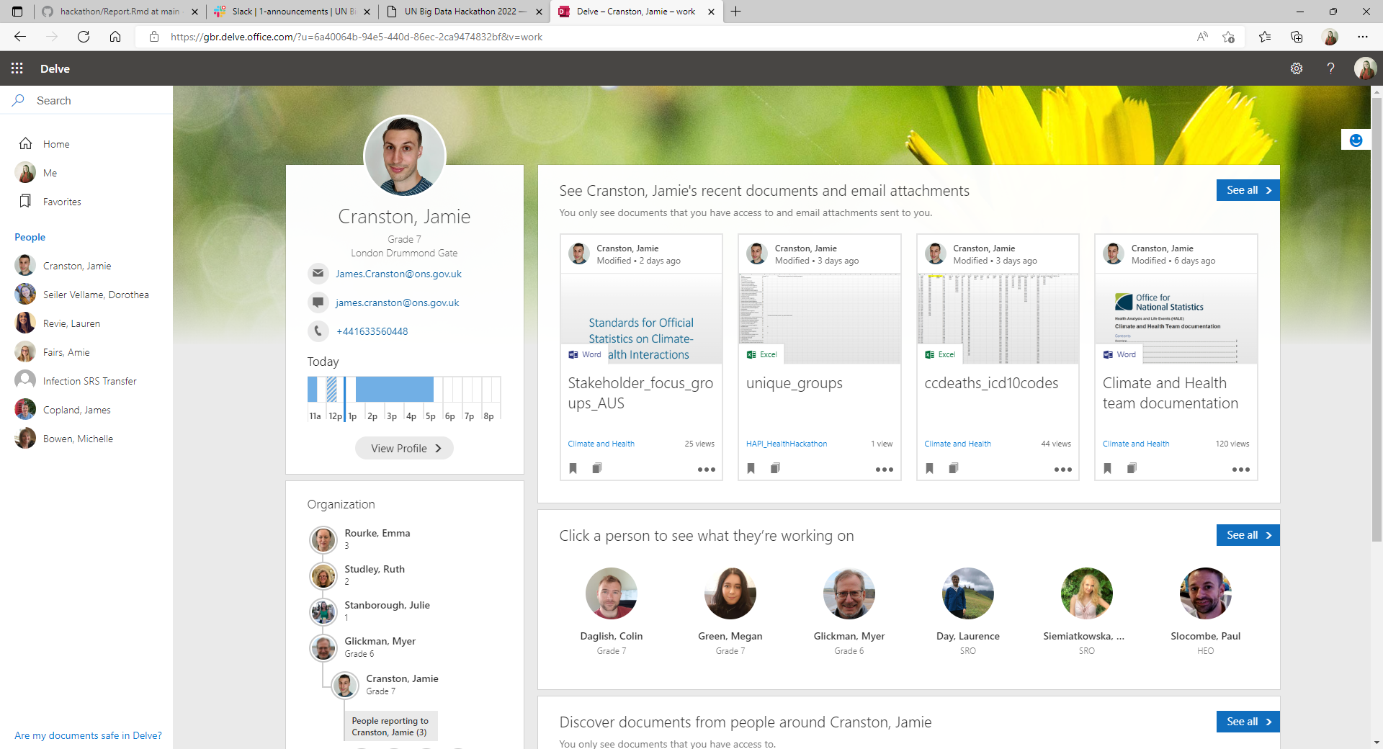
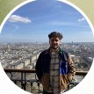
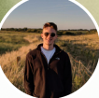
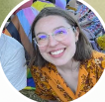
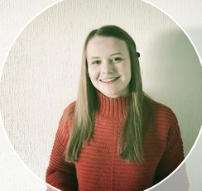
Who are we?
Jamie Cranston: Principal Analyst, Climate Change and Health, Office for National Statistics (UK).
Joel Jones: Senior Research Officer, Coronavirus Infection Survey, Office for National Statistics (UK).
Luis Dibdin: Senior Executive Officer, Coronavirus Infection Survey, Office for National Statistics (UK).
Dorothea Seiler Vellame: Research Officer, Coronavirus Infection Survey, Office for National Statistics (UK).
Claudia Jenkins: Research Officer, Coronavirus Infection Survey, Office for National Statistics (UK).

Slide 3

The Project
‘To support policies caused by the impact of Climate Change on society as part of monitoring SDG 13’
We decided to focus on two key SDG targets:
Target 13.2: Integrate climate change measures into national policies, strategies, and planning
Target 13.3: Improve education, awareness-raising and human and institutional capacity on climate change mitigation, adaptation, impact reduction and early warning.
Our Aim: To address the data gap between public awareness of climate change (using the UK as an example) and national policy to ensure policy makers have the appropriate information in one place for what society perceives as important priorities for combating climate change in relation to SDG 13.

Slide 4
Our Objectives
Objective 1: To use big data to produce a data visualisation for the number of climate-based protests occurring in the UK, disaggregated by event type, protest group and social-media support.
Objective 2: To analyse how climate attitudes vary across the UK using survey and social media data.
Objective 3: To understand how the UK public perceives current UK policies through survey-based data to inform an evaluation of their effectiveness.
Objective 4: To bring this information together into one interactive document (R Markdown) to provide a solution for accessing this information in one place and provide an example that could be scaled up to the global level.

Slide 5







The Data
For this project, we have used 6 main open-data sources, these are:
ACLED Data on UK Protests from 2020-2022.
Google Trends
Lloyds Register Foundation Risk Poll for Resilience from 2021.
Office for National Statistics (UK) Opinions and Lifestyle Survey from October 2021.
The Climate Change Twitter Dataset (Kaggle) for public options from 2006-2019.
Twitter data on the number of followers of Climate Action/Protest Groups (using Social Blade) from 2020-2022.
UK Department for Business, Energy, and Industrial survey data (BEIS) on public perceptions and awareness of Climate Change in the UK from September 2020 to October 2020.

Slide 6
Data Limitations and Challenges
ACLED – Only includes data from 2020-2022,limiting the scale of time series analysis. Time is a limitation of the BEIS and Lloyds data too.
Office for National Statistics (UK) Opinions and Lifestyle Survey – Only a high-level summary/subset of the data is open-sourced, limiting our analysis to a two-week period in October 2021.
Twitter Data (Social Blade and Kaggle) – not all the protest groups had verified twitter accounts; we only took data for the UK/Global groups and not local subgroups; there is potential bias in those who are active on social media platforms; we do not have information on the methodology used for the data stored by Kaggle.
Resolution: By using multiple ‘big’ datasets and local surveys, we have been able to provide an integrated analysis of UK perceptions of Climate Change that provides policy makers with a ‘one-stop-shop’ for understanding the impact of Climate Change on society.

Slide 7
Data Cleaning
For the ACLED Data:
Cleaned to only include the UK.
Protest groups were previously in one string, so they were split into individual groups.
These groups were characterised into whether they were climate related or not, with an additional column added to the data to determine this (based on additional research).
The dates for protests were converted to the data class using the lubricate package.
For the Opinions and Lifestyle Survey (ONS) Data:
The data contained a summary of the survey, split across age, sex, country, region, disability status, ability to afford unexpected expenses and parental status.
Each summary had a percentage for each answer as well as upper and lower quartiles; these answers were merged (e.g., all agree and strongly agree results merged).

Slide 8
The Product/Our Solution
Tool 1: A map of climate related protests in the UK, disaggregated by event type and organisation, with a separate graph for social-media support of protest groups.
Tool 2:
Tool 3: Public support of UK climate change policies.
The interactive document (R Markdown file) can be found here:

Slide 9
‘Scaling Up’ – Reproducibility
Challenges

Slide 10
Conclusions

Slide 11
References
ACLED Data on Global Protests: Data Export Tool - ACLED (acleddata.com)
BEIS Survey on Public Awareness and Perceptions of Climate Change: Climate change and net zero: public awareness and perceptions - GOV.UK (www.gov.uk)
Google Trends: https://trends.google.com/trends/?geo=GB,
Lloyds Risk Poll for Resilience from 2021: World Risk Poll Resilience Index - The Lloyd's Register Foundation World Risk Poll (lrfoundation.org.uk)
Options and Lifestyle Survey (ONS): Data on public attitudes to the environment and the impact of climate change, Great Britain - Office for National Statistics (ons.gov.uk)
The Climate Change Twitter Dataset: The Climate Change Twitter Dataset | Kaggle
Twitter Follower Information: https://socialblade.com/

